Slide 1

Exploratory Data Analysis
G2M Insight for Cab
Investment Firm
5/21/2023

Slide 2

Agenda
Executive Summary
Problem Statement
Approach
EDA
EDA Summary
Recommendations

Slide 3
Executive Summary
XYZ is a private firm in US. Due to remarkable growth in the Cab Industry in last few years and multiple key players in the market, it is planning for an investment in Cab industry and as per their Go-to-Market(G2M) strategy they want to understand the market before taking final decision.
Objective: Provide actionable insights to help XYZ firm in identifying the right company for making
investment.
The analysis has been divided into four parts:
Data Understanding
Forecasting profit and number of rides for each cab type
Finding the most profitable Cab company
Recommendations for investment

Slide 4
Problem Statement
Firm XYZ is currently preparing to make investments in the U.S cab industry due to the rapid growth this sector of the economy is experiencing and needs information on the cab market and a recommendation which company they should move forward and invest with

Slide 5
DATA Information
Dataset contains 4 different csv files:
Cab_Data
Includes details of the transactions for 2 cab companies
Customer_ID
Contains a unique identifier that links customer’s demographic details
Transaction_ID
Connects customer to transaction and payment method
City
Contains a list of US cities, their population and the number of cab users

Slide 6
Approach
Merge Datasets into one large dataset with each row of data linked to one customer and their specific transaction that day
Look at both Cab companies' performance as a whole and then look at the same metrics separately to see which company is better to invest in
Profit Variable Created in the dataset (Price Charged – Cost of Trip)

Slide 7
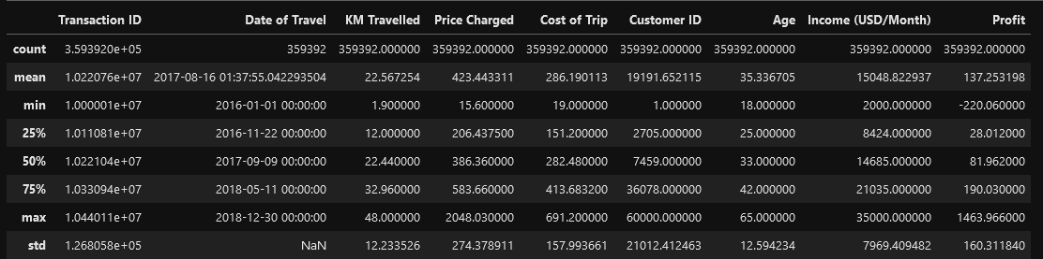
Overview of Cab Companies’ Performance

Slide 8
Income
The average income for the customers in both cabs, at 15,000 is above the average income in the United States. This makes sense as the clientele living in cities would make more than the average person in the same role due to the higher cost of living. In addition, the higher average income may be skewed due to the fact that cabs are a luxury mode of transportation in urban areas. Cheaper and just as fast modes of transportations in cities are readily available. Those with lower budgets for transportation would not use a cab and instead use a cheaper method such as a train or bus.

Slide 9
Age
The average age of the customers using the Cab is 35. The cab users are approaching middle age and nearing an age where they are likely to have settled into their careers. The older age may also be another reason for the higher-than-average income

Slide 10
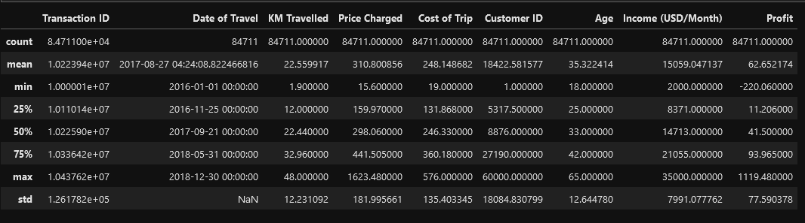
Overview of Pink Cab Company’s Performance

Slide 11
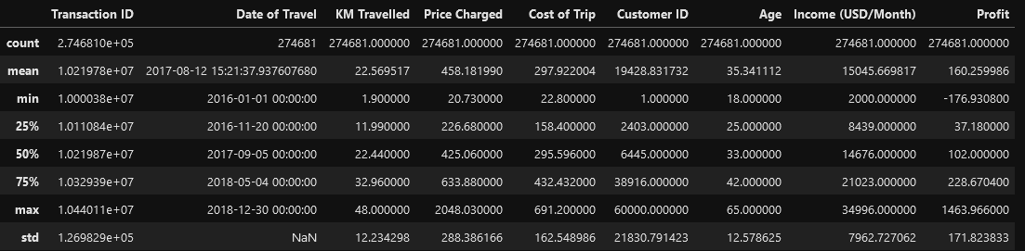
Overview of Yellow Cab Company’s Performance

Slide 12
Difference in Profit
There is a stark difference in the profit between the two cab companies. The Yellow cab company has over double the profit of the Pink cab company (160 vs. 62)

Slide 13
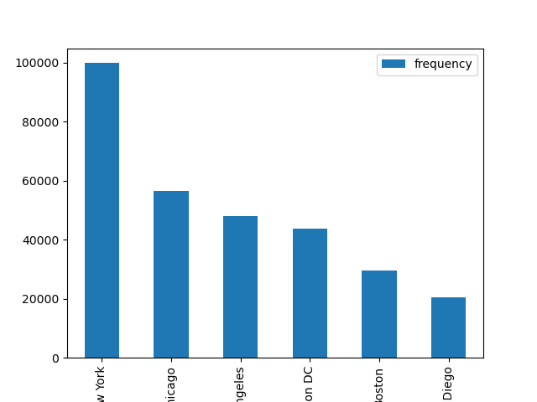
Top 6 Cities
The Top 6 Cities for both cities is as followed:
New York
Chicago
Los Angeles
Washington DC
Boston
San Diego

Slide 14
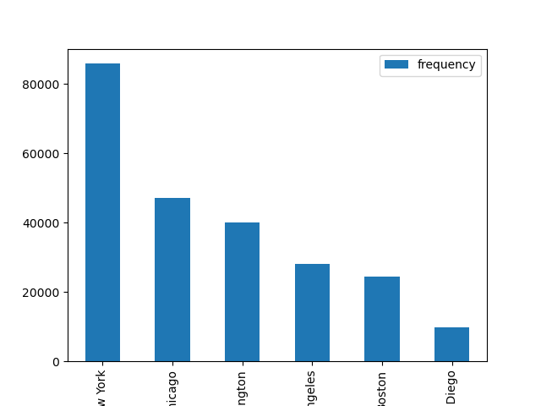
Yellow’s Top 6 Cities
The Top 6 Cities for both cities is as followed:
New York
Chicago
Washington
Los Angeles
Boston
San Diego

Slide 15
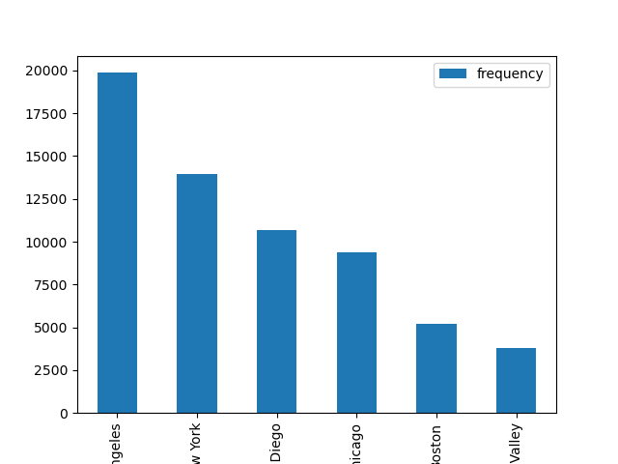
Pink’s Top 6 Cities
The Top 6 Cities for both cities is as followed:
Los Angeles
New York
San Diego
Chicago
Boston
Silicon Valley

Slide 16
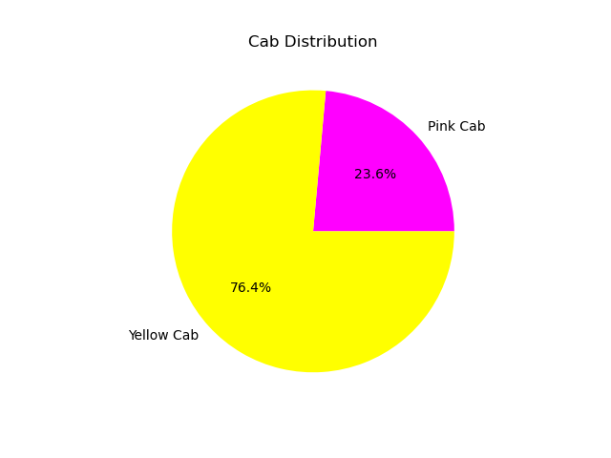
Cab Distribution
Yellow Cab three times the amount of business than Pink Cab’s, this is to be expected as Yellow has more business in the most populated cities compared to Pink. The

Slide 17
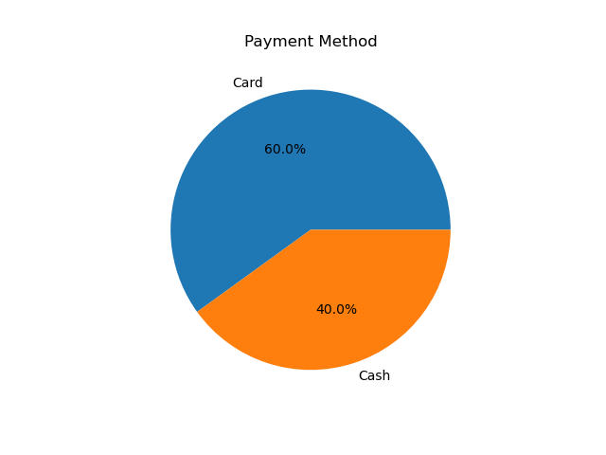
Payment Method Distribution
The most common payment method used in the Cabs is card. This follows recent trends in the United States in other industries. There has been a shift to cashless forms of payments due to the ease and accessibility of credit cards.

Slide 18
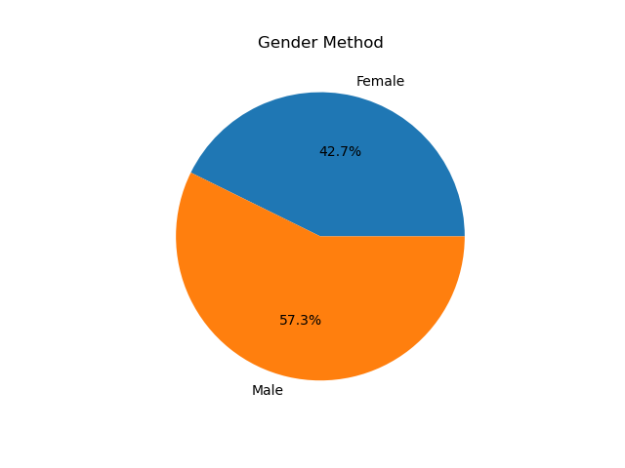
Gender Distribution
There are slightly more males using the cab service compared to women in both cab companies.

Slide 19
Recommendations
It is recommended that XYZ move forward to invest in the Yellow Cab Company for multiple reasons:
Market Share
Yellow has a higher market share than Pink. Meaning that they already have a higher customer base which could lead to higher profits
Top Cities
Yellow’s top active cities have a larger population and cities with more reliance on cabs than Pink’s. With more potential customers Yellow is predicted to over perform Pink in the long run
Profit
Yellow currently has higher profits than Pink and with their market share and top cities, it is likely that their higher profits will continue.

Slide 20
Thank You

